Slide 1
Context-Free Languages (CFL)
CSC3113: Theory of Computation
9
4
Summer 2022-2023
Sharfuddin Mahmood, Assistant Professor,
Department of Computer Science, Faculty of Science & Technology.
smahmood@aiub.edu

Slide 2
Formal Definition of CFL
Context Free Grammar (CFG)
Designing CFG

Slide 3
Concept and Definition of Context Free Language (CFL)
Concept and Construct of Context Free Grammar (CFG)
Designing CFG

Slide 4
All outcome are represented with examples
Learn the concept and Formal Definition of CFL
Understand the construct of CFG
Learn and Design CFG for languages

Slide 5
Context-Free Languages
Context-Free Languages includes all regular languages and many additional languages, such as {0^{n}#1^{n} | n ≥ 0}.
Additional memory is used to recognize such languages.
Context-Free Grammars.
More powerful method of describing language.
Can describe certain features that have a recursive structure.

Slide 6
Example: Context-Free Grammars
A → 0A1 A → 0A1 | B
A → B or B → #
B → #
A grammar consists of a collection of Substitution (or Production) rules.
Each rule appears as a line in the grammar.
Each line has a variable and a string separated by an arrow.
Variable consists of a symbol.
represented as uppercase letters.
might include index or subscript.
Strings consists of variables and/or other symbols called terminals.
terminals are analogous to input alphabet, represented as lowercase letters, numbers, or special symbols.
might include index or subscript.
One variable is designated the start variable, usually the left-hand side of the topmost rule.
Several rules for the same left-hand variable can be written using “|” as an “or”.

Slide 7
Context-Free Grammars
Use a grammar to describe a language by generating each string of the language in the following manner –
Write down the start variable, s.
Choose a variable v from the right-hand side of the rule for s.
Find a rule that starts with (or left-hand side is) v.
Replace v in rule s by right-hand side of rule v.
Repeat from step 2 to 4 until no more variables remains.
The sequence of substitutions to obtain a string is called derivation. Derivation of string 000#111 in the grammar –
A → 0A1 | B B → #
A⇒ 0A1⇒ 00A11⇒ 000A111⇒ 000B111⇒ 000#111
Using Parse Tree: Figure on the right
A
A
A
A
B
0
0
0
#
1
1
1

Slide 8
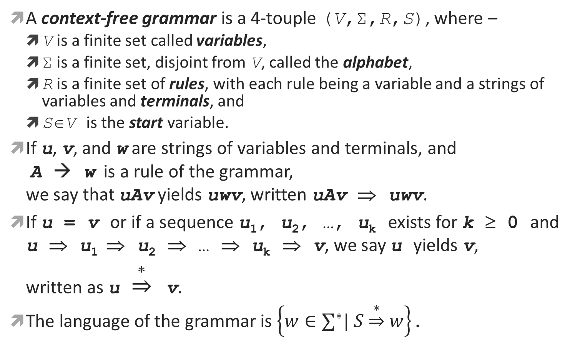
Formal Definition
A context-free grammar is a 4-touple (V,Σ,R,S), where –
V is a finite set called variables,
Σ is a finite set, disjoint from V, called the alphabet,
R is a finite set of rules, with each rule being a variable and a strings of variables and terminals, and
S∈V is the start variable.
If u, v, and w are strings of variables and terminals, and A → w is a rule of the grammar, we say that uAv yields uwv, written uAv ⇒ uwv.
If u = v or if a sequence u₁, u₂, …, u_{k} exists for k ≥ 0 and u ⇒ u₁ ⇒ u₂ ⇒ … ⇒ u_{k} ⇒ v, we say u yields v, written as u $\underset{⇒}{∗}$ v.
The language of the grammar is $\left\{w∈∑^{∗}| S\underset{⇒}{∗}w\right\}$.

Slide 9
Designing
CFG that is union of simpler CFGs:
Break into simpler pieces and Construct individual grammars for each piece.
Combine them into one grammar by putting all the rules together and adding a new rule, S → s₁ | s₂ |…| s_{k}, where the variables s_{i} are the start variables for the individual grammars.
Example: {strings containing n, n≥0, number of 0s and 1s} = {1^{n}0^{n} | n≥0} ∪ {0^{n}1^{n} | n≥0}
{0^{n}1^{n} | n≥0} can be represented S₁ → 0S₁1 | ε
{1^{n}0^{n} | n≥0} can be represented S₂ → 1S₂0 | ε
{1^{n}0^{n} | n≥0} ∪ {0^{n}1^{n} | n≥0} can be represented S → S₁ | S₂ S₁ → 0S₁1 | ε S₂ → 1S₂0 | ε

Slide 10
Designing
CFG for regular language:
Construct a DFA M=(Q, Σ, δ, q₀, F) for the regular language.
Convert the DFA M into equivalent CFG as follows –
Variable R_{i} for each state q_{i}∈Q. Make R₀ the start variable for the start state q₀.
Add rule R_{i} → aR_{j} to the CFG for each δ(q_{i}, a) = q_{j}.
Example: Language: A = {w | the sum of all the symbols in w is an even number } DFA: M=(Q, Σ, δ, q₀, F), where, Q={b₀,b₁}, q₀=b₀, F={b₀},Σ={0,1,2}
δ | 0 1 2 b₀ | b₀ b₁ b₀ b₁ | b₁ b₀ b₁
CFG: Grammar G = (V, Σ, R, R₀), where, V = {R₀, R₁}, Σ = {0, 1, 2}, and R is the set of rules R₀ → 0R₀ | 1R₁ | 2R₀ | ε R₁ → 0R₁ | 1R₀ | 2R₁

Slide 11
Designing
Language containing strings with two substrings that are linked or depended on each other by their number of appearances.
Use rule of the form R → uRv.
This generates strings wherein the portion containing the u’s corresponds to the portion containing v’s.
Example: Language: {1^{n}0^{n} | n≥0} CFG: S → 1S0 | ε

Slide 12
Designing CFG
A={ w | w begins with a and ends with b } | S → aTb T → aT | bT | ∈
A={ w | w begins with b or ends with a } | S → bT | Ta T → aT | bT | ∈
A={ w | w contains at least 3 a‘s } | S → TaTaTaP T → bT | ∈ P → aP | bP | ∈
A={ w | w contains at most 3 a‘s } | S → BABABAB A → a | ∈ B → bB | ∈
A={ w | w contains the substring aba } | S → TabaT T → aT | bT | ∈
A={ w | w does not contain the substring aba } | S → bS | aT | ∈ T → aT | bR | ∈ R → bS | ∈
A={ w | every odd position of w is a } | S → aT | ∈ T → aS | bS | ∈
A={ w | w = a^{m}b^{n} and m = n} | T → aTb | ∈

Slide 13
Designing CFG
A={ w | w has even length } | S → aT | bT T → aP | bP P → aT | bT | ∈
A={ w | w = a^{m}b^{n} and m > n} | S → AT T → aTb | ∈ A → aA | a
A={ w | each a in w is followed by at least one b } | S → BabBT B → bB | ∈ T → abBT | ∈
A={ w | w has even number of a‘s and each a in w is followed by at least one b } | P → BabBT T → abBS S → abBT | ∈ B → bB | ∈
A={ a^{i}b^{j}c^{k} | where i = j or j = k and i, j, k ≥ 0} and ∑ = {a, b, c} | S → PR | QT P → aPb | ∈ R → cR | ∈ T → bTc | ∈ Q → aQ | ∈

Slide 14
Context Free Language & Grammar
Introduction to Theory of Computation, Sipser, (3rd ed), CFL-1.
Elements of the Theory of Computation, Papadimitriou (2nd ed), CFL-1.
Introduction to Automata Theory, Languages, and Computations, Hopcroft, CFL-1.

